Slide 1

MAMC01801 Capabilities for Managers
Week 2

Slide 2
Agenda
At the end of the session, students will be able to:
Identify the elements in the 7S model
Apply the 7S model in a case study
Differentiate Fayol and Katz’s capabilities for managers
Learn the purpose of a capability framework and evaluate a capability within a framework.

Slide 3
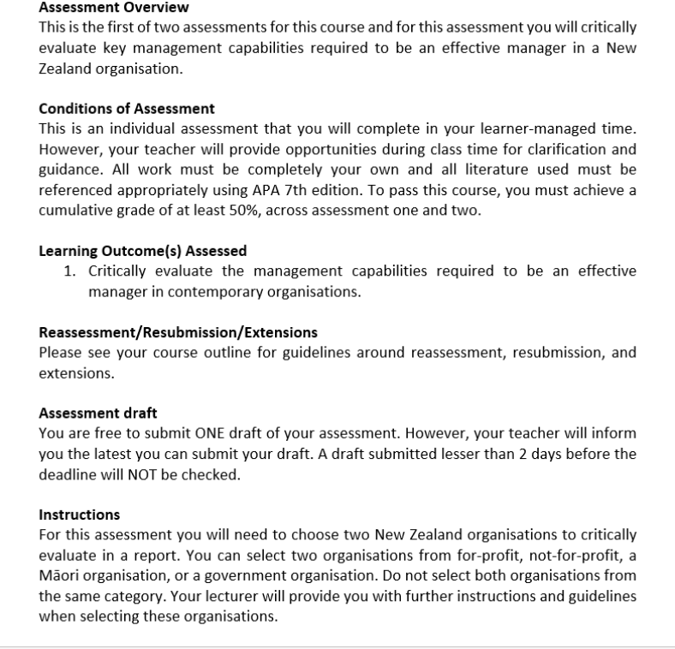
Assessment 1: Report (20% of final grade)
Word count guidance: 2000 words (+/- 10%)
Due date: Friday Week 3 (25 October 2024), 11:59 PM

Slide 4
Feedback for Assessment One
Written Feedback:
If you would like to obtain written feedback for your draft for Assessment One (or some paragraphs, or even just key points or outline), please upload your draft via Teams Assignments before Thursday morning (17 October, Week 2), 8.30 AM. The feedback will be released before Wednesday (23 October, Week 3).
Any questions? Feel free to contact me on Teams!

Slide 5
What is an organisation?
The Oxford Dictionary says, “a structured group of people with a particular purpose.”
This definition allows inclusion of private and public sector, for-profit and non-profit, large and small, product and service orientation.
Organisations are formed in response to the reality that their activities are too complex for one person to carry out alone.
So, we need a positive environment for people to work in, an effective way of getting them to do that work, and an efficient model of internal structure to support their efforts.

Slide 6
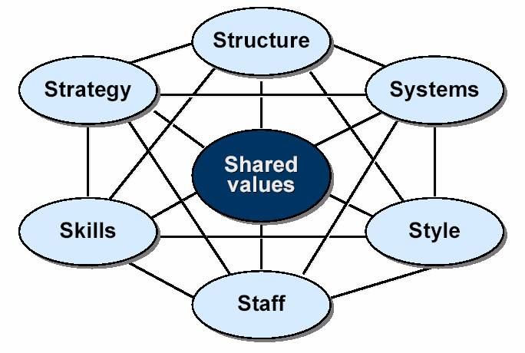
The 7S Model of an organisation
7S Model video

Slide 7
Shared values and strategy
Values: the main elements of philosophy or principle that guide the activities of the organisation, the non-negotiable beliefs that decide how the organisation behaves.
The organisation’s values underpin everything that it does and are highly influential over the choice of strategy.
Strategy: a statement of what the organisation wants to achieve in the long term, and the main activities it will undertake in order to realise those ambitions.
The other five S words reflect the approach that each organisation takes to pursuing its strategic ambitions.

Slide 8
Structure, staff and style
Structure: the methods by which available resources are arranged in support of the organisation’s strategic objectives, the methods by which individual staff members are grouped together in a series of interlinked work units.
Staff: the number of people involved in the organisation’s activities, the effectiveness with which these people work together as a team, and the processes in place to recruit, develop, and reward them.
Style: the “personality” of an organisation in terms of the ways in which it goes about its business. Includes the degree of centralised control versus delegated responsibility, organisational attitudes to change, degree of innovation in its products and services etc.

Slide 9
Skills and systems
Skills: the individual attributes that make a person suitable for employment in the organisation, including a consideration of the specific capabilities these people need to possess.
Systems: the processes in place to enhance the Efficiency + Effectiveness = Productivity equation. These systems may be manual, automated, or commonly a blend of both.
A combination of skills and systems reflects the approach the organisation takes in making its products and services available to its customers or service users.

Slide 10
Exercise 1:The 7S Model in action
Refer to Activity 1. Setting up your new company, which is in this week’s folder.
Imagine that your group are the shareholders in a new start up company, formed for a specific organisational purpose, and that you have been charged with establishing the desired start‐up profile of this company in line with the 7S Model. The specific purpose assigned to your company is noted in the exercise and is followed by a series of questions related to each of the 7S elements.
Prepare and deliver an oral presentation that includes your answers to those questions, and that suggests any valuable lessons that we might learn from consideration of those answers. You will do a follow-up exercise using this company later in the block.

Slide 11
The PESTLE analysis See the reading New Zealand PESTLE report 2021
What are the PESTLE elements?
- Political
- Economic
- Societal
- Technological
- Legal
- Environmental/Ecological
How can they be applied to an organisation or a country?

Slide 12
What can managers learn from PESTLE?
The rate of change in the external environment is extremely rapid, is accelerating, and is unlikely to slow down.
Many influences in the external environment offer an opportunity, or poses a threat, to your organisation.
The assessment of any influence as an opportunity or as a threat has more to do with the attitudes of the assessor than it has to do with the nature of the influence.
The individual manager cannot hope to control many of these influences but must continually do their best to understand them.

Slide 13
Exercise 2: PESTLE factors in the general business environment.
Using Activity 2. PESTLE in the business environment, which can be found in the Week 2 folder, work as Individuals to allocate the appropriate term to the contents.
You will be asked to share your findings with the class.

Slide 14
What is a manager?
A review of various dictionary definitions reveals multiple answers.
There is no real agreement across all of those definitions
One way to investigate further is to look at the criteria that have been used to distinguish a good manager from a not-so-good one.
Here we introduce, very briefly, the ideas of Henri Fayol, the grandfather of modern management principles, and some ideas from Robert Katz. There is more detail in the Capabilities Frameworks ppt.

Slide 15
What do managers do?
Henri Fayol initially thought managers were active in 14 separate areas of involvement, but these were later refined to four key activities:
Planning: the process of determining a future course of action for the organisation.
Leading or the process of motivating and inspiring the employees of the organisation.
Organising, or the process of efficiently and effectively arranging and deploying available resources
Controlling, or the process of monitoring and measuring the activities of organisational employees.
https://www.mindtools.com/asjiu77/henri-fayols-principles-of-management

Slide 16
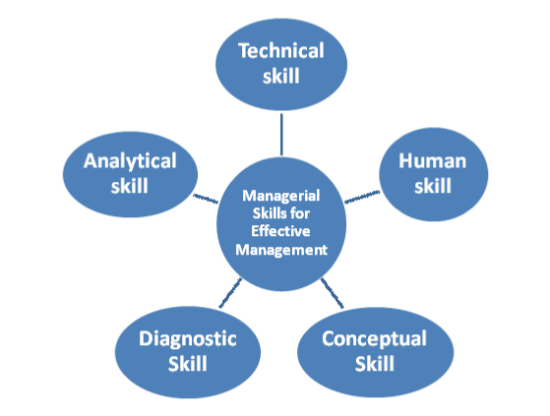
What skills does the manager need?

Slide 17
Robert Katz: Three core skill areas
Technical skills were the single most important qualification for a managerial position. It is now less necessary than they once were; One does not have to be a good doctor to manage a successful medical practice.
Increased emphasis on human skills, or the ability to relate to other people (inside and outside of the organisation) that bests support the organisation’s ambitions. They build a Positive internal culture, Develop co-operative stakeholder relationships, and Successfully manage conflicts and disputes.

Slide 18
Robert Katz: Three core skill areas
Conceptual skills require the manager to take a “BIG PICTURE” view of what s/he is doing. Here the manager will focus on the overall purpose for which the organisation has been created, the broadly defined activities it will need to engage in to achieve that purpose, and the tangible and intangible resources required if those activities are to be successfully implemented.

Slide 19
Two supporting skill areas
Analytical skills are used to assess the current and anticipated conditions in the external environment, and in adopting such practices as environmental scanning, market research, and scenario planning
Diagnostic skills are used to review a specific management challenge, and to correctly interpret that challenge in the form of an accurate problem definition, specification of a range of possible responses, and selection of the most suitable solution.
https://granite.pressbooks.pub/ld820/chapter/6/

Slide 20
GROUP Activity: Capability Framework
Please answer the following questions:
What is the purpose of a Capability Framework?
Choose one Capability Framework and explain its structure.
Select one Capability from the Capability Framework chosen above that is suitable for one of your organisations. Then discuss how your organisation’s managers can be effective and efficient in demonstrating this capability.

Slide 21
GROUP Activity: Capability Framework
Reference below includes different sets of capability frameworks and the lecture slide:
University of Otago
Educational Leadership
Māori Crown Relations
Response and Recovery Leadersip Capability Framework
Finance Capability Framework for Government Finance Professionals
Project Leadership Capability Framework
Capability Framework lecture slides in Teams Week 2 Folder (also found in Moodle – Module 2)
Share your thoughts with the class.

